Slide 1
TEAM WORK
Tanaguru Contrast Finder
Omer Omer
Josh Bingham
Eduardo Abreu

Slide 2
Tanaguru Contrast Finder
Finds a valid background / foreground color contrast for accessibility
Java

Slide 3
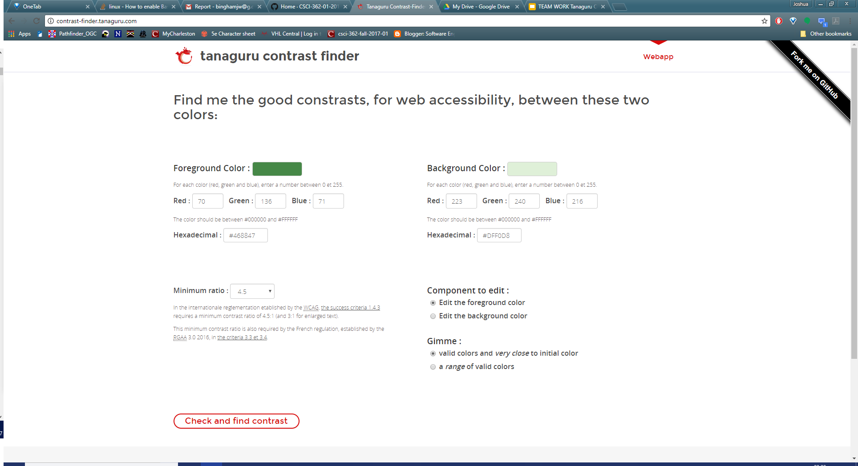
Tanaguru Contrast Finder

Slide 4
Test Cases
Test Case Template
Test Case Example
1. ID= #XXX
2. Class being tested (File path from .\project\src with extension)
3. Method being tested (only the name)
4. Requirement Being run
5. Inputs (arguments required to make the input object/primitive)
6. Driver Filename without extension
7. Expected result (if error, type Error)
ID= #002
/contrast-finder-utils/src/main/java/org/opens/utils/distancecalculator/DistanceCalculator.java
calculate
Works for identical inputs
100,100,100 100,100,100
distanceColorDriver
0.0

Slide 5
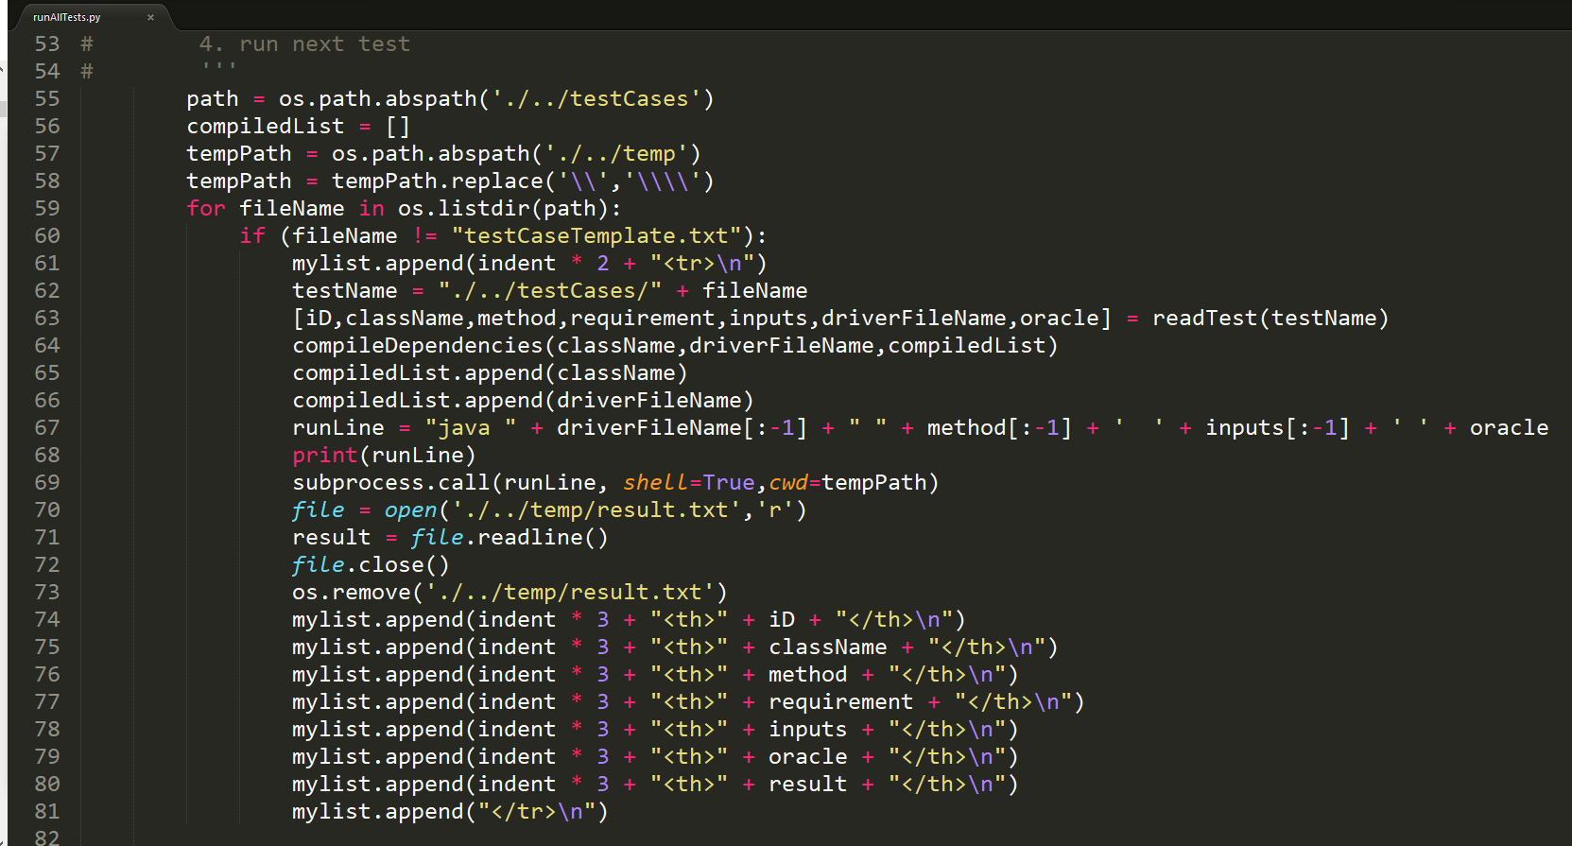
Our Script
Main bulk of the script
Iterates through test cases
Compiles necessary files
Runs Java Executable
Reads output
Adds output to html page

Slide 6
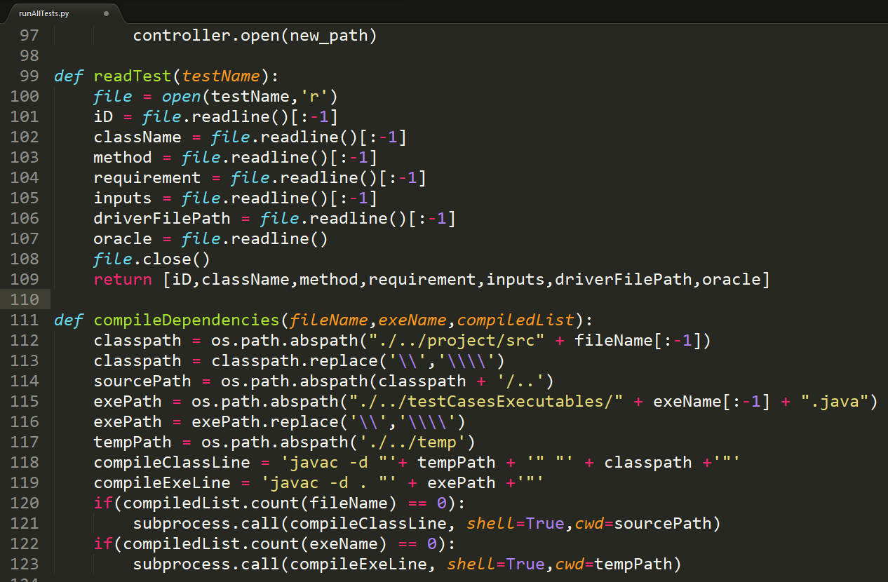
Our Script
readTest
Gets passed test name
Processes Test Case file
Returns list containing the data
[:-1] removes newLine Characters
compileDependencies
Checks if Executable and Project file have been compiled
If not, compiles them
Uses suprocess.call to execute javac through the command line

Slide 7
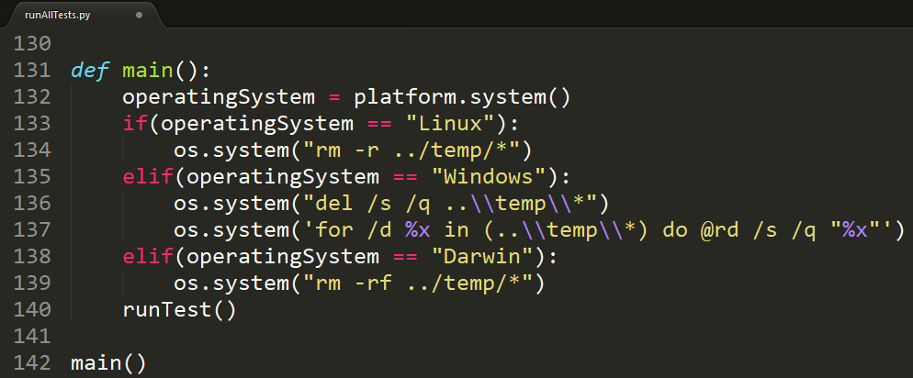
Our Script
Main method
Checks the operating system
Uses the appropriate method to clear the temp/ folder for the os
Runs the testing method (runTest)
Can be modified to accept more operating systems

Slide 8
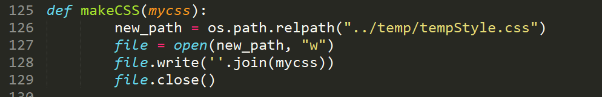
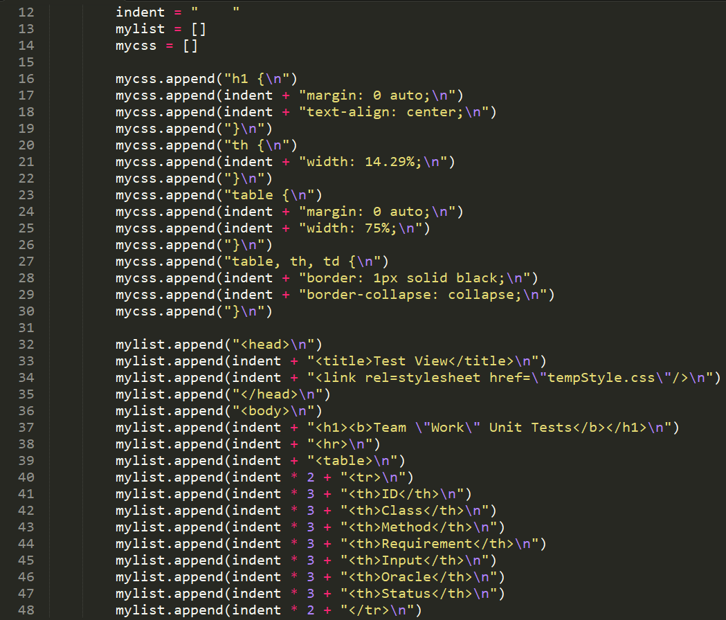
Our Script
makeCSS
Assembled the CSS into a “.css” file so that the html can use external css to format the page.
makeHTML
Assembles the HTML in our script and output the HTML file. It then opens the HTML file automatically.

Slide 9
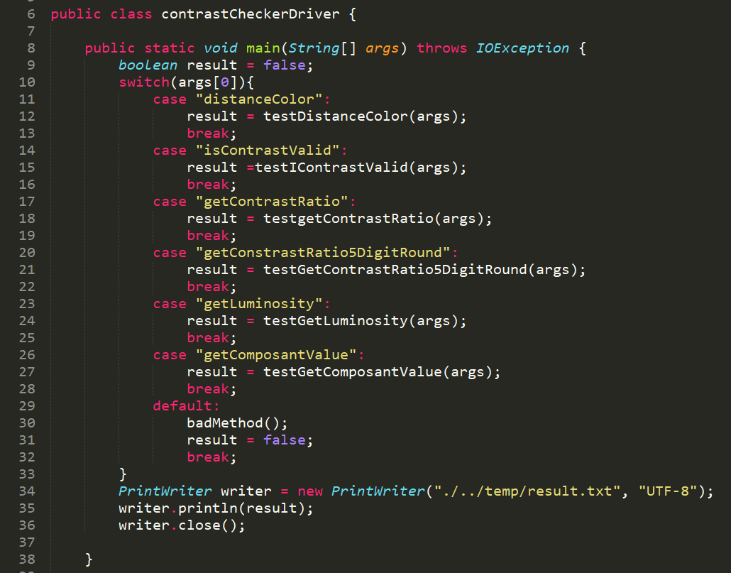
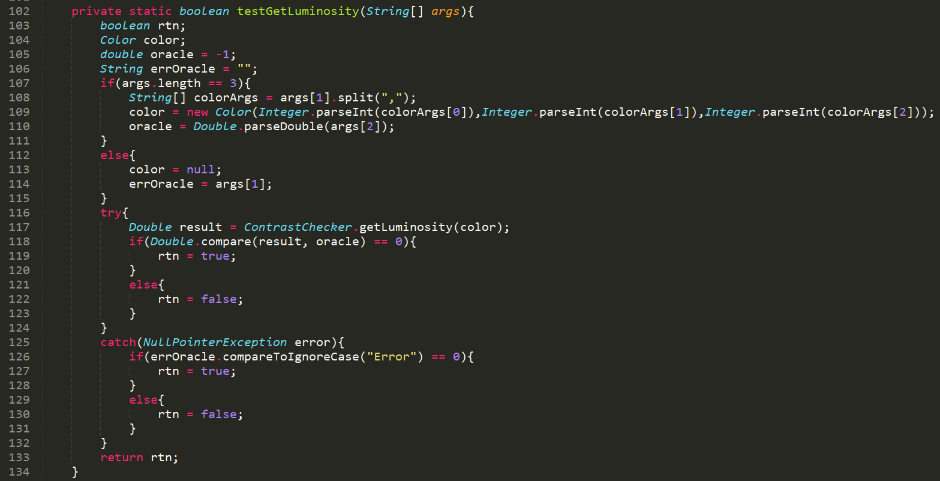
Executable Example

Slide 10
What we learned
Creating a driver
Make a script to run tests
Create faults in code
Accessing Java from Python

Slide 11
Problems we faced
Time management
Making deadlines
Keeping each other in check
Communication
Linux/Windows/Mac differences

